Slide 1

Electric Vehicle Support Infrastructure
Case Study 2

Slide 2
Basic Analysis
Trends

Slide 3
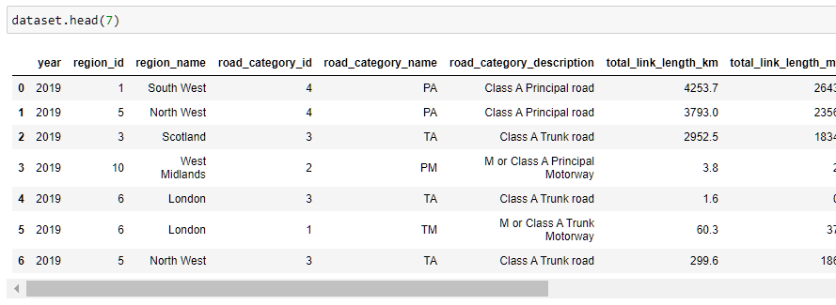
Data Cleaning
Regional traffic dataset
Understanding structure
Minimal Cleaning
No missing entries

Slide 4
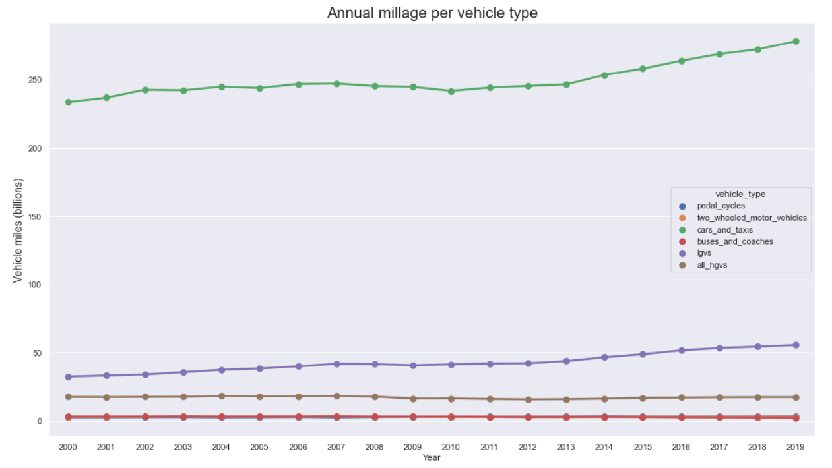
Annual millage per vehicle type
Cars, taxis and LGVS millage increase
Cars and Taxis
19% increase
LGVS
71% increase
Other vehicle type, constant millage

Slide 5
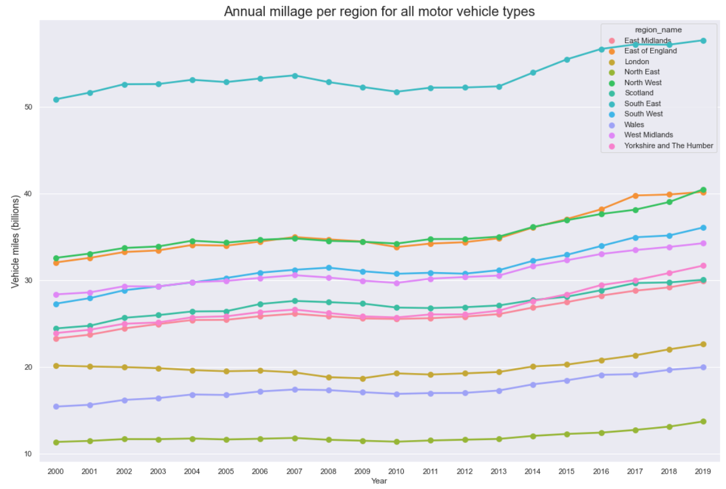
Annual millage per region for all motor vehicle types
North East having the least vehicle millage
South East most millage
Constant increase throughout all regions

Slide 6
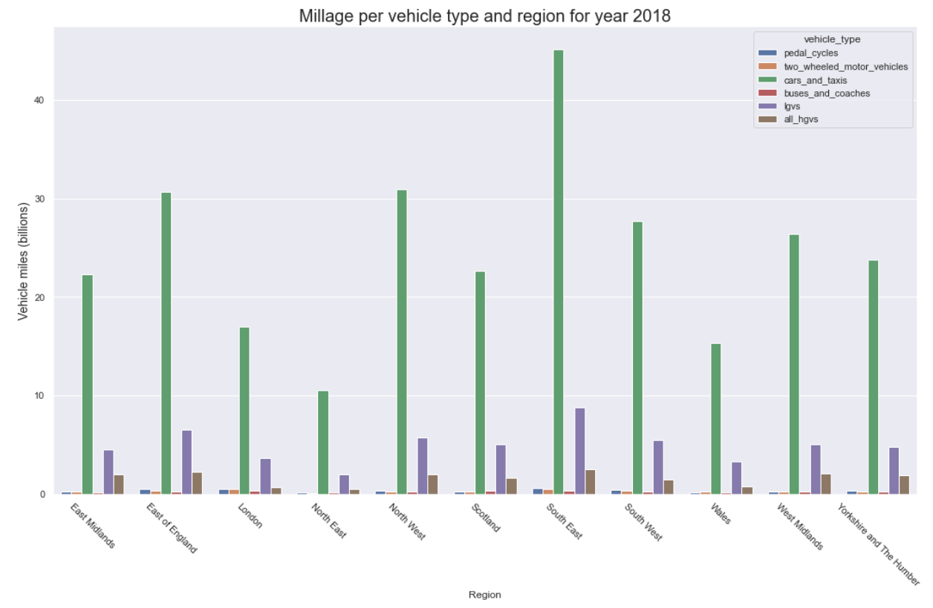
Millage per vehicle type and region for year 2018
South east’s cars and taxis millage difference

Slide 7
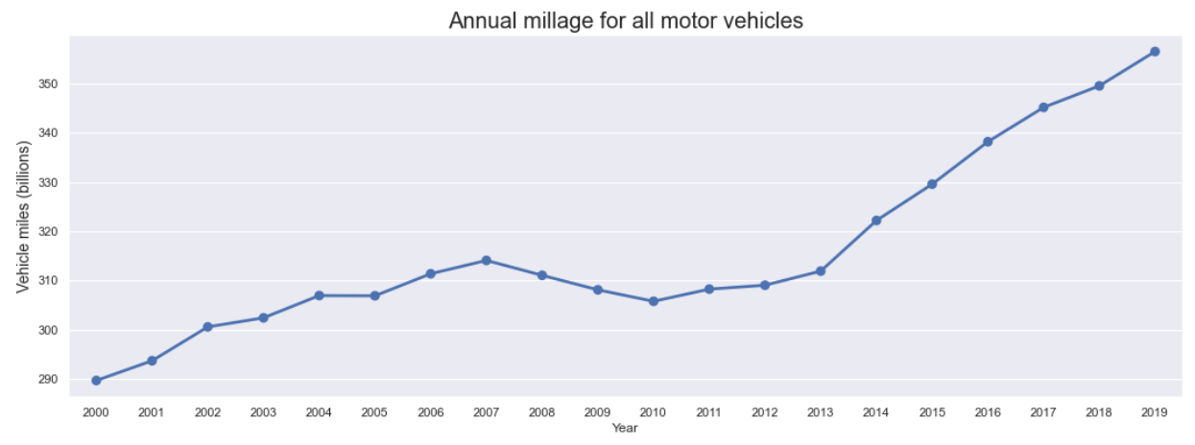
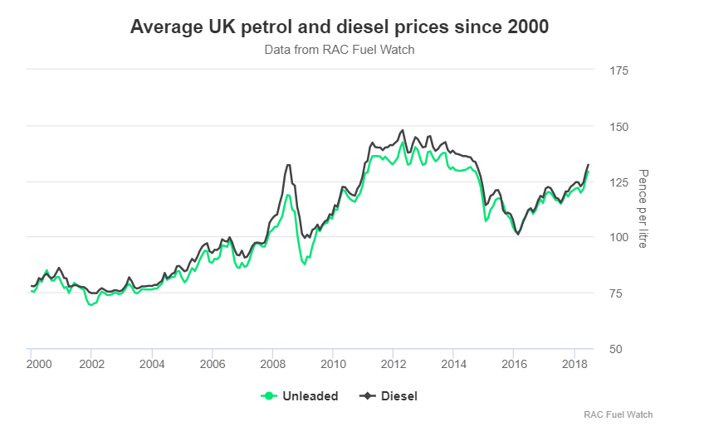
Annual millage for all motor vehicles
23.5% increase in total UK millage through years 2000 to 2019.
Trend Factors
Rise
Population increase
Affordability of vehicles
Dip
Changes in fuel Price
Economic Downturns
(media.rac, 2018)
Notes:
https://media.rac.co.uk/blog_posts/average-uk-petrol-and-diesel-prices-over-time-72742

Slide 8
Regression
Forecasting

Slide 9
Time Series Forecasting Models
ARIMA, SARIMA
Exponential smoothing
Prophet
LSTM

Slide 10
ARIMA (Autoregressive Integrated Moving Average)
One of most widely used approaches to time series forecasting
Does not require a set of predictor variable
It uses its history as an explanatory variable (hence the name Autoregressive)
It is a univariate model
Notes:
Univariate model which in our case have
Since we have no seasonal trends no need to use SARIMAX
https://www.quora.com/What-are-the-pros-and-cons-of-the-ARIMA-model-over-regression
https://towardsdatascience.com/an-overview-of-time-series-forecasting-models-a2fa7a358fcb
https://towardsdatascience.com/arima-vs-prophet-forecasting-air-passenger-numbers-4e01b2d93608

Slide 11
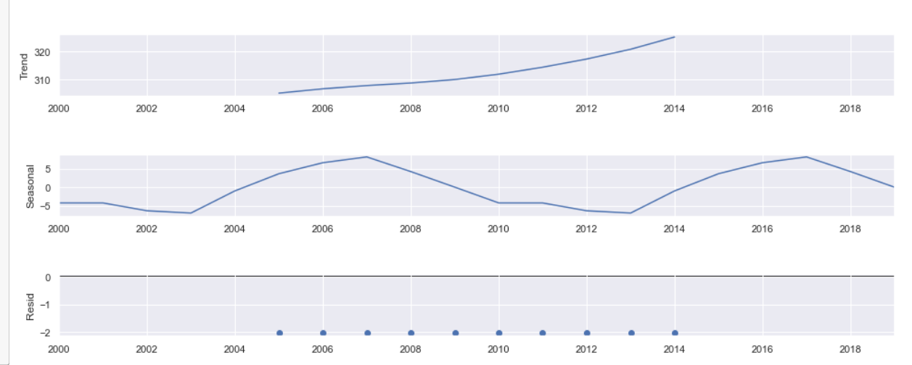
ARIMA (Autoregressive Integrated Moving Average)
Seasonal Decomposition
Trends
Residuals
Notes:
https://www.analyticsvidhya.com/blog/2015/12/complete-tutorial-time-series-modeling/

Slide 12
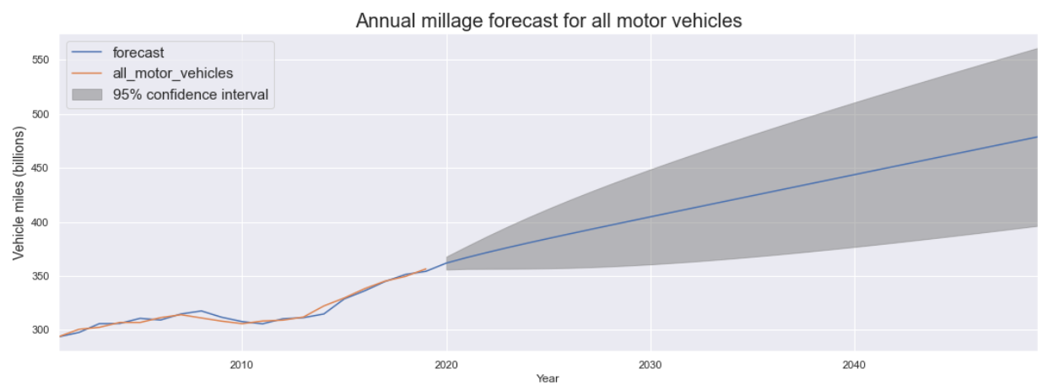
ARIMA Forecasting
Notes:
Confidence interval decreases for longer forecasts. Constant incline

Slide 13
Research
Electric vehicle Impact

Slide 14
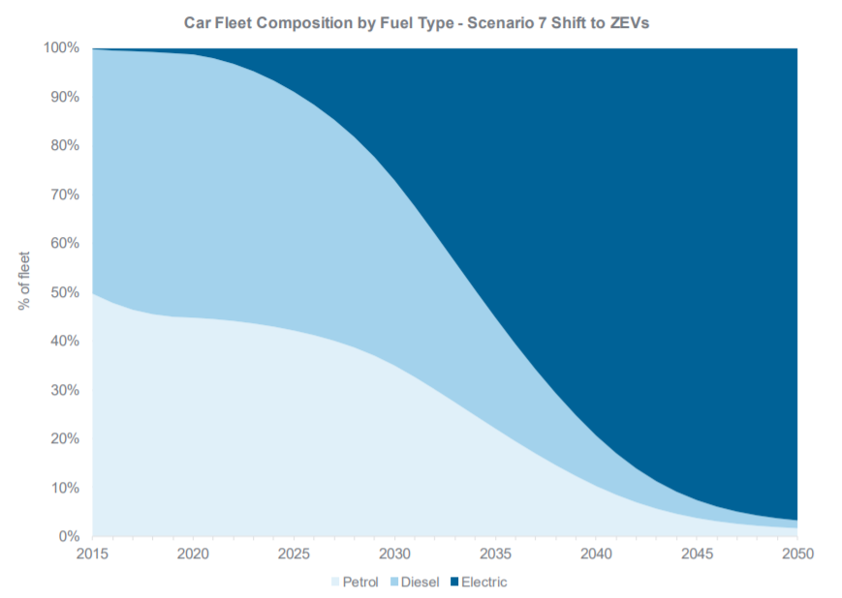
UK’s Shift to Zero Emission Vehicles
Factors
Government supporting factors such as policies, targets and grants.
Availability/Affordability of models
Number of charging ports increasing, more accessible
(Department for Transport, Road Traffic Forecasts 2018, 2018)
Notes:
https://assets.publishing.service.gov.uk/government/uploads/system/uploads/attachment_data/file/873929/road-traffic-forecasts-2018-document.pdf (p. 42)

Slide 15
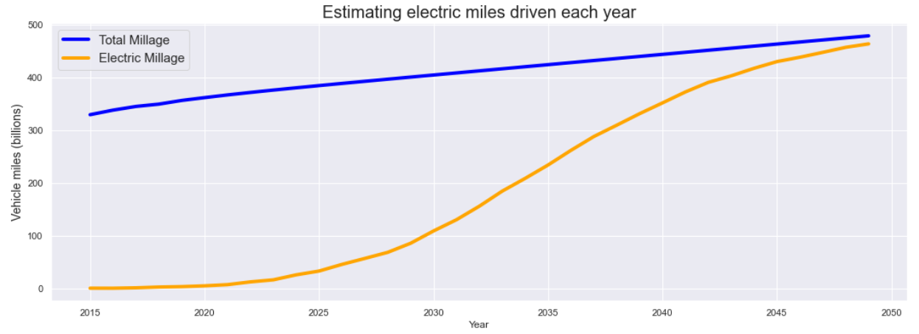
Estimating number of electric miles driven each year

Slide 16
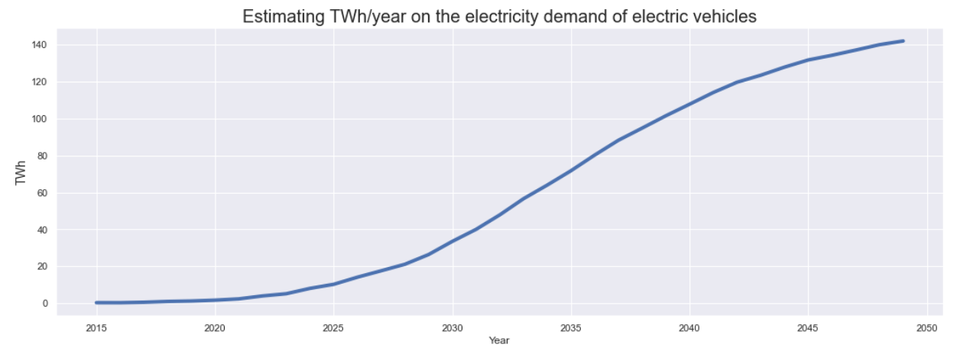
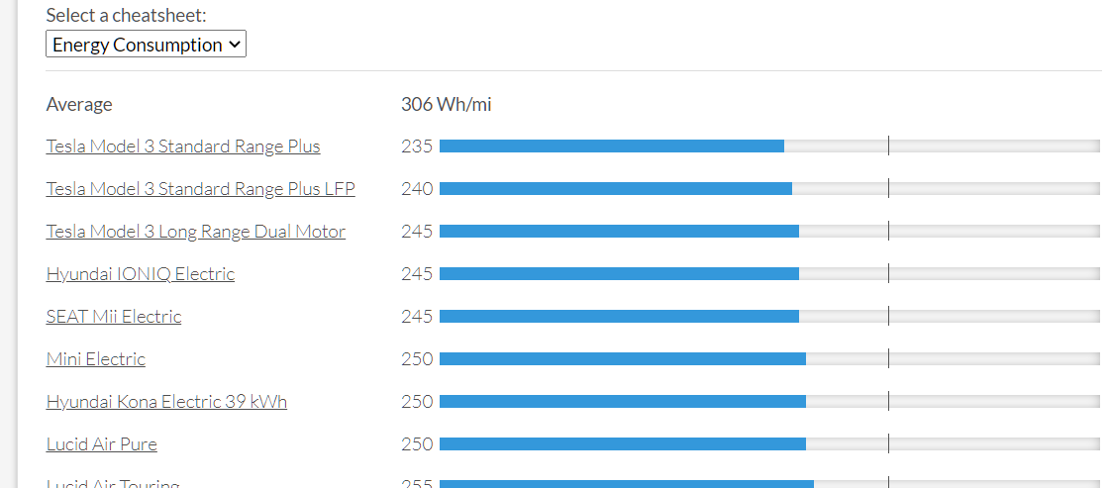
Estimated power generation
Using the estimated electric miles driven
Using average energy consumption of 306 Wh/mi
Calculated from the energy consumption of an Electric Vehicle Database
Notes:
https://ev-database.uk/cheatsheet/energy-consumption-electric-car

Slide 17
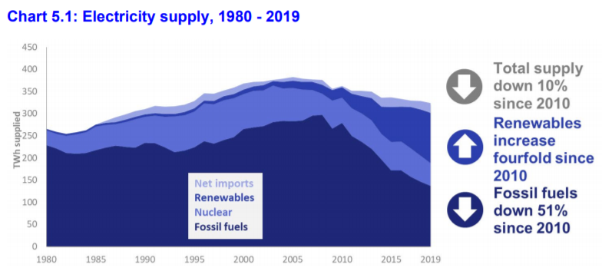
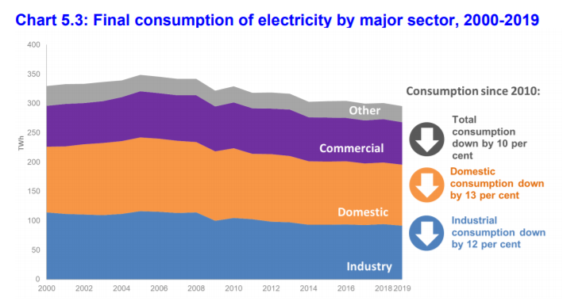
Identifying UK’s Electricity Margin
Supply
Demand
(Dukes, Chapter 5, 2020)
(Dukes, Chapter 5, 2020)
Notes:
https://assets.publishing.service.gov.uk/government/uploads/system/uploads/attachment_data/file/904805/DUKES_2020_Chapter_5.pdf (p. 3,5)

Slide 18
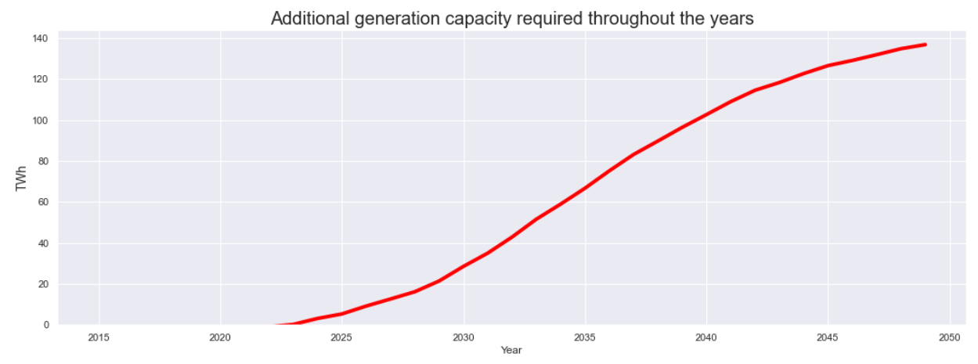
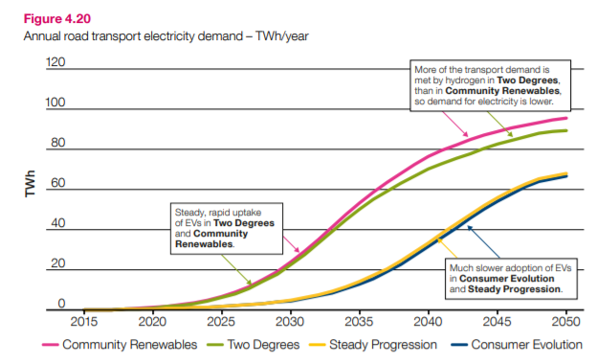
Calculated Additional Power Generation Required
Independent estimate of the likely generation required
(NationalgridESO, 2019)
Notes:
https://www.nationalgrideso.com/document/170756/download (p. 82) Figure 4.20

Slide 19
Recommendation
Meeting Electricity demands

Slide 20
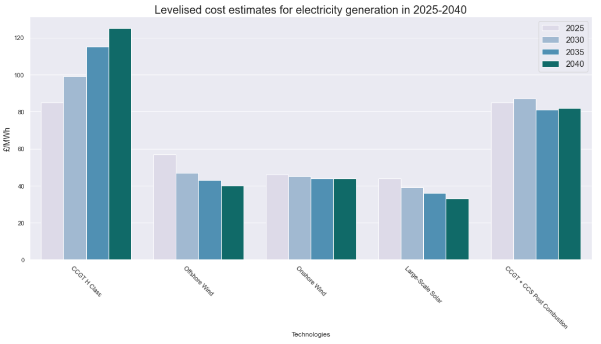
BEIS Levelised Estimates per Technology
(BEIS, 2020)
Notes:
https://assets.publishing.service.gov.uk/government/uploads/system/uploads/attachment_data/file/911817/electricity-generation-cost-report-2020.pdf (P.35)

Slide 21
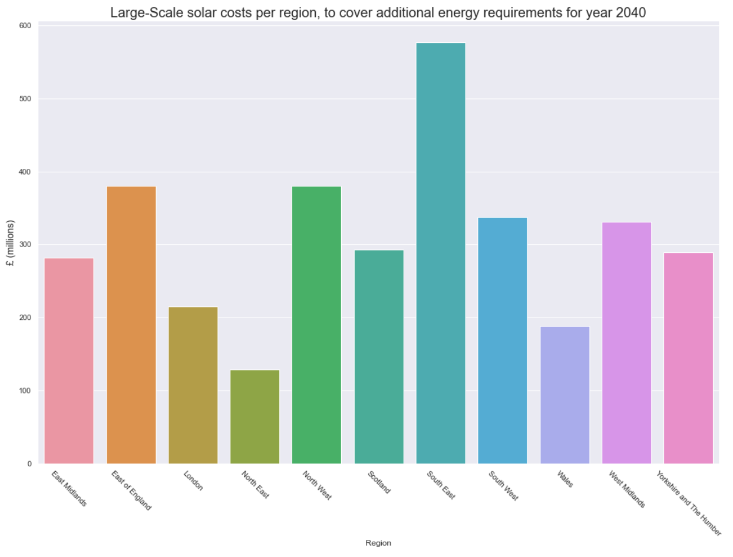
100% Solar
Notes:
Using 100% solar to cover the additional energy demand required for the electric vehicles we require that much for each region to run.

Slide 22

Technologies Region comments
London – Wind, Solar
Seaside regions – Offshore Wind

Slide 23
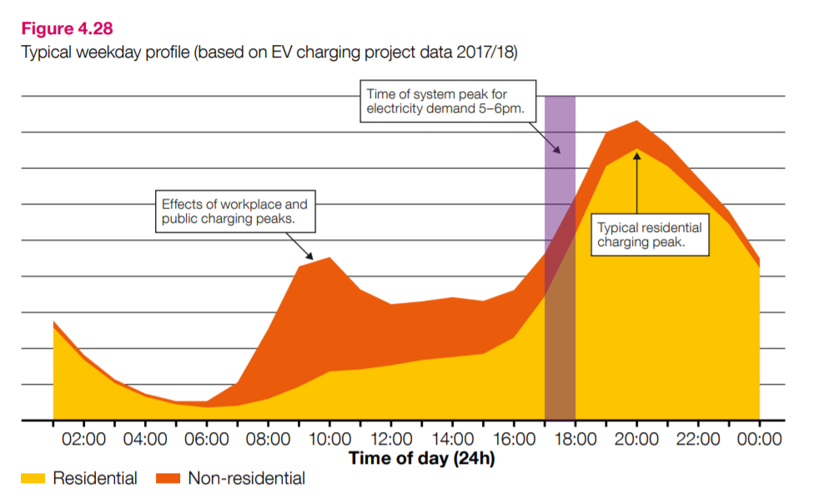
Time of day charging impact
Enough supply to handle peaks
Large peak at around 22:00
Grid energy storage does not have enough batter capacity
Constant energy sources
(NationalgridESO, 2019)
Notes:
https://www.nationalgrideso.com/document/170756/download (p. 91) Figure 4.28

Slide 24
Recommendation comments
More renewables
Taking advantage of region positioning
Use some expensive technologies to cover peak demand
Can not be dependent only on natural renewable sources as they are unreliable
Solar unstable for UK’s weather conditions
Notes:
Mostly use renewable energies such as Wind and Solar. Taking advantage of the positioning of the region

Slide 25
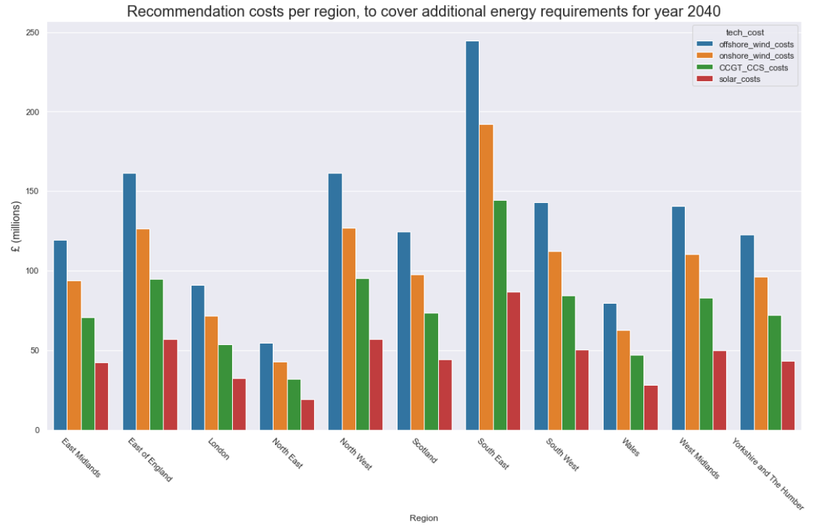
Recommendation
35% OffShore Wind
25% Onshore Wind
25% CCGT + CCS Post Combustion
15% Large-Scale Solar
Region dependent, but can be suitable in general

Slide 26
The End

